Slide 1
Intro to VIM
Adam Hamot

Slide 2
Setup
Install VIM for your respective platform
Explained on the Facebook event page, also URL below
Clone/Download the Github repo
http://zamn.net/hacktorial (shortlink to the actual repo)
Move .vimrc to:
Windows: C:\Users\your_username\
Linux/Mac: /home/your_username/
Type:
vim vim_tut.c (inside of the repo directory)
We are good to go!

Slide 3
Overview
Why you might want to use VIM
Advantages/Disadvantages
Learn VIM
Modes
Movement
Fundamentals
Live Code Edit
Miscellaneous
Resources

Slide 4
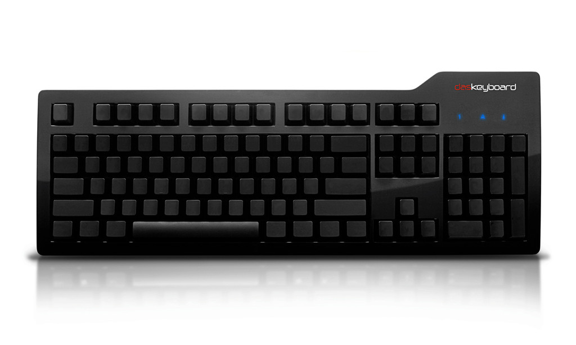
About Me
Avid VI/VIM user for the past ~2 years.
Use VIM for everything besides writing Java/C#.
Eclim
VsVim
Touch typist
Mechanical Keyboard Enthusiast

Slide 5

Why do I want to learn VIM (adv)?
You look like a pro and will surely impress your friends.
Ridiculously efficient
Less friction
Know VIM? Now you know VI.
Can work on most platforms
Linux, Mac, Windows
Shell usage

Slide 6
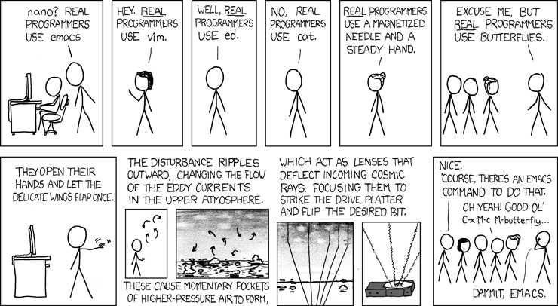
Why do I want to learn VIM (disadv)?
Favors Touch Typists
Does not work well with the mouse
Learning Curve
Not very graphical

Slide 7
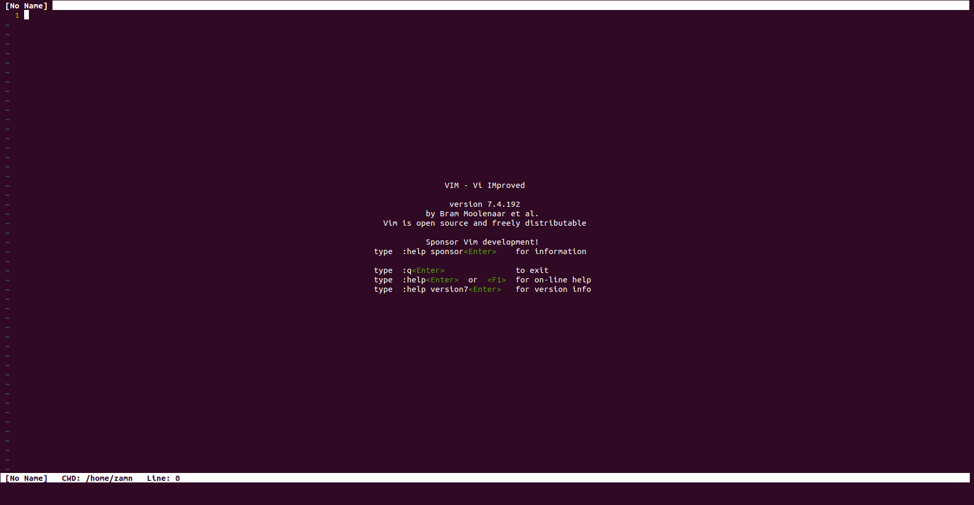
Lets Get Started!

Slide 8
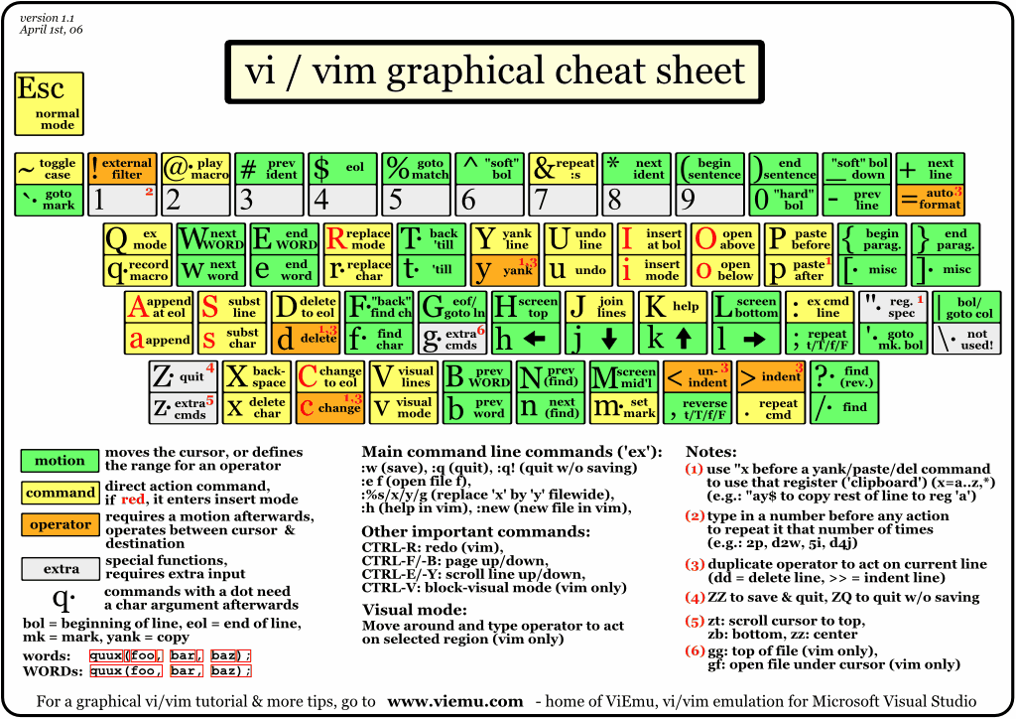

Slide 9

Modes
Normal Mode (Also known as Command)
Insert Mode
Visual Mode
Paste Mode

Slide 10
Normal Mode
Default mode upon opening VIM
Activated using the ‘Escape’ key
Or using ctrl + [
The most used mode where we will be doing all of our magic
Movement
Line/Document
Screen
Edits (Insert Mode)
Modifying lines/characters
Organization
Window Splits
Misc
Searching/Ex mode

Slide 11
Line/Character Movement
Make sure caps lock is off!
h = ‘move left’
j = ‘move down’
k = ‘move up’
l = ‘move right’
Alternatively you can use arrow keys
Not recommended

Slide 12

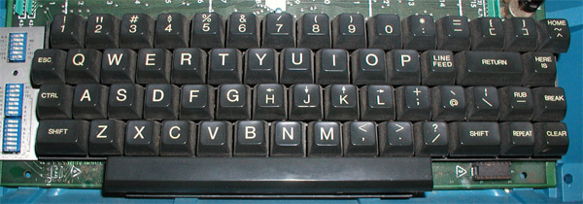
hjkl, what?!

Slide 13
Interactive Demo
Load up the vim_tut.c file and lets vim!

Slide 14
Miscellaneous
Plugins
Vundle
https://github.com/gmarik/Vundle.vim
Tagbar
https://github.com/majutsushi/tagbar
Airline
https://github.com/bling/vim-airline
Autoclose
https://github.com/Townk/vim-autoclose

Slide 15
Resources
http://reddit.com/r/vim
##vim on irc.freenode.net
http://vimadventures.com
:help in vim
vimtutor in terminal

